Slide 1
Objects and Classes
Objects, Class Definition & Members

Slide 2
content
Enumerations
Introduction to OOP
Classes
Objects
Tasks solving

Slide 3
Enumerations
Enumerations contain a fixed list of special constant values
E.g. standard colors – red, green, blue, yellow, orange, etc.
E.g. currencies – USD, BGN, GBP, etc.
E.g. automobile fuel type – Petrol, Diesel, Electricity

Slide 4
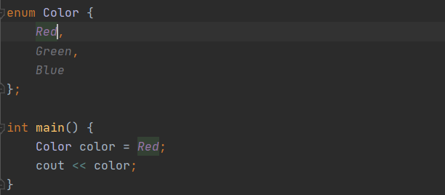

Slide 5
Representing the Real World in Code
So far our data types were essentially “just numbers”
int, float and double are obviously numbers
char is also a number, although treated like a symbol
arrays of the above types are still just numerical data
The physical world CAN be represented entirely by numbers
Computers work with 1s and 0s anyway

Slide 6
Representing the Real World in Code
In the real world, we usually talk about "objects"
e.g.: Peter, United Kingdom, Nasko's Car
Objects have attributes/properties, e.g.: age, population, fuel
Objects can sometimes do things, e.g.: talk, leave EU, break
There are usually multiple objects of the same type/class
Peter, Georgi, Nasko are all people
United Kingdom, Bulgaria, Egypt are all countries
Object-oriented programming focuses on such classes & objects

Slide 7
Object-Oriented Programming
Introduces ways to group data into user-defined data types
E.g. a Person type, a Country type, a Car type, etc.
Variables defined in a user-defined type are called “fields”
Such types are called “classes”
Variables with such a type are called “objects”
In addition to data, we can add functions to a class
Functions in a class are called methods

Slide 8
Classes
In programming, classes provide the structure for objects
User-defined data types
Act as a template for objects of the same type
Definition contains the class “members”:
Fields, Methods, Constructors, Destructors
One class may have many instances (objects)

Slide 9
Objects
Any variable of a class-defined data type
Operator. (dot) is used for accessing members of an object
The instance is the object itself, which is created runtime
All instances have common behaviour

Slide 10
Defining classes – Live demo

Slide 11
Using objects
Creating a variable of a class data type
Objects follow the same rules as normal variables
Can be passed as copy to a function or by reference with &
Can be put into arrays, vectors, etc.

Slide 12
Using objects – live demo

Slide 13
Structs
https://github.com/NaskoVasilev/Introduction-To-Programming/tree/main/11_Structs

Slide 14
Struct vs class
In C++ struct and class mean exactly the same thing, except:
class by default uses private: at the start
struct by default uses public: at the start
i.e. class with public at the start is the same as a struct
The C++ community usually prefers class for actual classes

